Slide 1



Automation
with Ansible
Notes:
The University of Melbourne
MELBOURNE RESEARCH
www.research.unimelb.edu.au

Slide 2
Automation
Deploying complex cloud systems requires a lot of moving parts
  Easy to forget what software you installed, and what steps you took to configure the system
  Manual process is error-prone, can be non-repeatable
  Snapshots are monolithic - provide no record of what has changed
Automation
  Provides a record of what you did
  Codifies knowledge about the system
  Makes process repeatable
  Makes it programmable – “Infrastructure as Code”
Notes:
The University of Melbourne
MELBOURNE RESEARCH
www.research.unimelb.edu.au

Slide 3
Classification of Scripting tools
Cloud-focused
  Used to interact with Cloud services.
  Apache JClouds (Java-based - supports multiple clouds)
  Boto (Python - supports AWS and OpenStack)
  OpenStackClient (Python - supports OpenStack)
  CloudFormation (YAML/JSON - supports AWS, OpenStack Heat)
Shell scripts
  Bash
  Perl
Notes:
The University of Melbourne
MELBOURNE RESEARCH
www.research.unimelb.edu.au

Slide 4
Classification of Scripting Tools
Configuration management (CM) tools
  Configuration management refers to the process of systematically handling changes to a system in a way that it maintains integrity over time.
  Automation is the mechanism used to make servers reach a desirable state, previously defined by provisioning scripts using tool-specific languages and features.
  Chef (uses Ruby for creating cookbooks)
  Puppet (uses its own configuration language)
  Ansible (use YAML to express playbooks)
  Fabric (Python library that uses SSH for application deployment and administration tasks)
  Terraform, SaltStack, Docker, …
Notes:
The University of Melbourne
MELBOURNE RESEARCH
www.research.unimelb.edu.au

Slide 5
Ansible
An automation tool for configuring and managing computers
  Finer grained set up and configuration of software packages
Initial release: Feb. 2012
Combines multi-node software deployment
Ad-hoc task execution and configuration management
  Configuring thousands of machines manually!?
Machine (e.g. Vanilla Ubuntu)
Machine in desired state (e.g. Ubuntu + Apache 2)
Ansible playbooks
Notes:
The University of Melbourne
MELBOURNE RESEARCH
www.research.unimelb.edu.au

Slide 6
Ansible: Features
Easy to learn
  Playbooks in YAML, templates in Jinja2 etc.
  Sequential execution
Minimal requirements
  No need for centralized management servers/daemons
  Single command to install (pip install ansible)
  Uses SSH to connect to target machine
Idempotent (repeatable)
  Executing N times no different to executing once
  Prevents side-effects from re-running scripts
Extensible
  Write your own modules
Notes:
The University of Melbourne
MELBOURNE RESEARCH
www.research.unimelb.edu.au

Slide 7
Ansible: More Features
Supports push or pull
  Push by default but can use cron job to make it pull
Rolling updates
  Useful for continuous deployment / zero downtime deployment
Inventory management
  Dynamic inventory from external data sources
  Execute tasks against host patterns
Ansible Vault for encrypted data
  $ ansible-vault create demo.yaml
  $ ansible-vault decrypt demo.yaml
  $ ansible-vault encrypt demo.yaml
  $ ansible-vault rekey demo.yaml
Notes:
The University of Melbourne
MELBOURNE RESEARCH
www.research.unimelb.edu.au

Slide 8
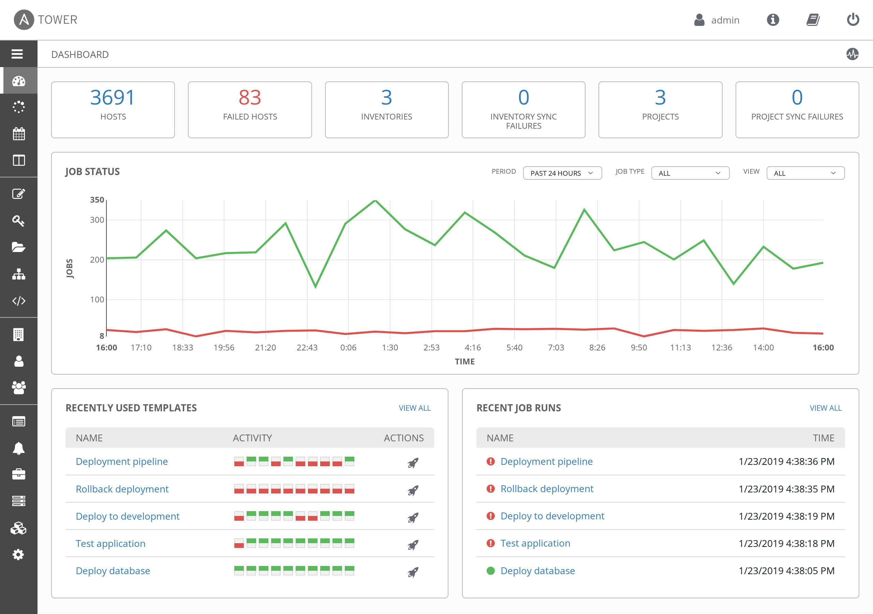
Ansible: More Features
Ad-hoc commands
  Execute a one-off command against your inventory
  $ ansible -i inventory_file -u ubuntu -m shell -a “reboot”
Ansible Galaxy (https://galaxy.ansible.com/)
Ansible Tower: Enterprise mission control for Ansible
  Dashboard, System Tracker, etc.
Notes:
The University of Melbourne
MELBOURNE RESEARCH
www.research.unimelb.edu.au

Slide 9
Ansible: YAML & Jinja2
Ansible Playbooks are expressed in YAML.
  YAML: YAML Ain’t Markup Language
  YAML is a human friendly data serialization standard for all programming languages.
  YAML Syntax: https://docs.ansible.com/ansible/latest/reference_appendices/YAMLSyntax.html
Ansible uses Jinja2 templating for dynamic expression
  Jinja2 is a modern and designer-friendly templating language for Python, modelled after Django’s templates.
  Jinja2 introduction: https://docs.ansible.com/ansible/latest/user_guide/playbooks_templating.html#templating-jinja2
Notes:
The University of Melbourne
MELBOURNE RESEARCH
www.research.unimelb.edu.au

Slide 10
Ansible: Installation Guide
Linux (Ubuntu)
  $ sudo apt-get update && sudo apt-get install software-properties-common
  $ sudo apt-add-repository --yes --update ppa:ansible/ansible
  $ sudo apt-get install ansible
macOS
  Brew (https://brew.sh/)
    $ brew install ansible
  Pip
    $ sudo pip install ansible
Notes:
The University of Melbourne
MELBOURNE RESEARCH
www.research.unimelb.edu.au

Slide 11
Ansible: Installation Guide
Windows 10 (WSL)
  Install Windows Subsystem for Linux
    https://docs.microsoft.com/en-us/windows/wsl/install-win10
  Install Ansible
    See guide for Linux (Ubuntu)
  Tutorial
    https://www.youtube.com/watch?v=9g0IGoRJtzM
Ansible documentation:
https://docs.ansible.com/ansible/latest/installation_guide/intro_installation.html
Notes:
The University of Melbourne
MELBOURNE RESEARCH
www.research.unimelb.edu.au

Slide 12
Ansible: Structure
Ansible scripts are called playbooks, written as simple YAML files
Structured in a simple folder hierarchy
Playbook folder
|- variables
| |_ vars.yml
|- inventory
| |_ inventory.ini
|- roles
| |- defaults
| |- tasks
| | |- task1.yml
| | |_task2.yml
| |_ templates / files
|_ playbook.yml
[webservers]
foo.example.com
128.250.0.1
[dbservers]
one.example.com
two.example.com
Notes:
The University of Melbourne
MELBOURNE RESEARCH
www.research.unimelb.edu.au

Slide 13
Ansible: Playbooks
Executed sequentially from a YAML file
- hosts: webservers
vars:
package: [‘httpd’, ‘python-dev’]
tasks:
- name: Ensure the latest Apache and Python are installed
apt:
name: “{{ package }}”
state: latest
- name: Write the Apache config file
file:
src: /srv/httpd.conf
dest: /etc/httpd.conf
- name: Ensure Apache is restarted
service:
name: httpd
state: restarted
[webservers]
www[01:50].example.com
192.168.0.[1:254]
Notes:
The University of Melbourne
MELBOURNE RESEARCH
www.research.unimelb.edu.au

Slide 14
Ansible Demo: Melbourne Research Cloud
Ansible Demo 1:
Connect to Melbourne Research Cloud
List all images
Create volumes
Create security groups with security rules
Launch an instance and attach the volume and security groups
Create snapshots of the volumes
Notes:
The University of Melbourne
MELBOURNE RESEARCH
www.research.unimelb.edu.au

Slide 15
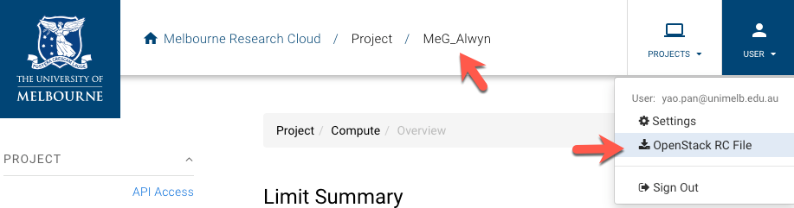
Ansible Demo: Melbourne Research Cloud
Prerequisites:
  Login to https://dashboard.cloud.unimelb.edu.au
  Download openrc.sh from Dashboard
    Make sure the correct project is selected
    Download the OpenStack RC File
Notes:
The University of Melbourne
MELBOURNE RESEARCH
www.research.unimelb.edu.au

Slide 16
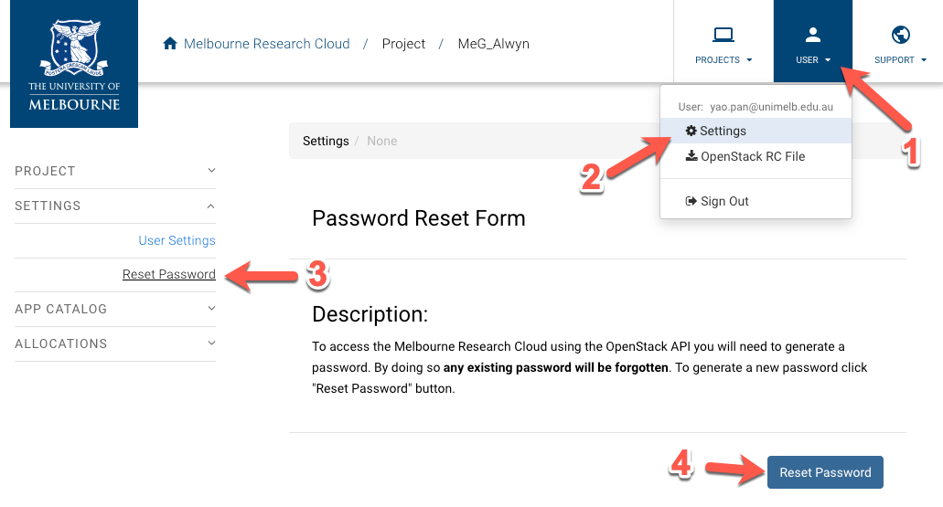
Ansible Demo: Melbourne Research Cloud
Prerequisites:
  Reset API password
  Dashboard -> User -> Settings -> Reset Password
Notes:
The University of Melbourne
MELBOURNE RESEARCH
www.research.unimelb.edu.au

Slide 17
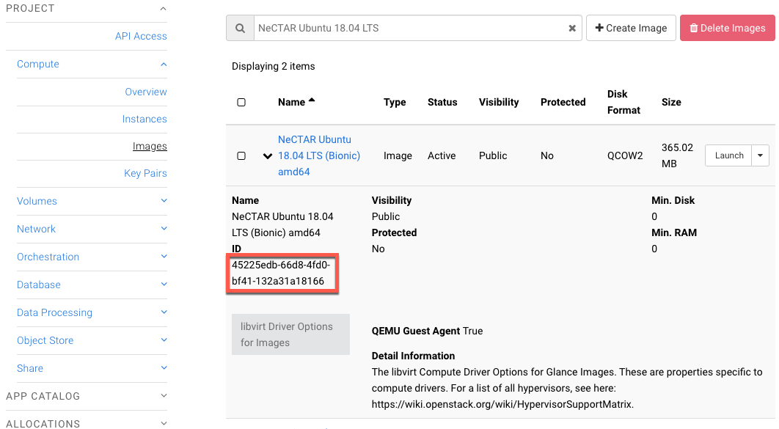
Ansible Demo: Melbourne Research Cloud
Prerequisites:
  Instance Flavor: uom.general.2c8g
  Availability Zone: melbourne-qh2-uom
  Image Id: 45225edb-66d8-4fd0-bf41-132a31a18166
    Dashboard -> Compute -> Images
Notes:
The University of Melbourne
MELBOURNE RESEARCH
www.research.unimelb.edu.au

Slide 18
Ansible Demo: Melbourne Research Cloud
playbook to interact with Melbourne Research Cloud
  List all images
  os_image_info
  Create a volume
  os_volume
  Create a security group with rules
  os_security_group, os_security_group_rule
  Launch an instance and attach the volume and security group
  os_server
  Create a snapshot of the volume
  os_volume_snapshot
  Other Ansible modules used
  apt, pip, become, register, set_fact, debug, loop
  when, wait_for, add_host, gather_facts
Run playbook:
$ . ./openrc.sh; ansible-playbook [--ask-become-pass] nectar.yaml
Notes:
The University of Melbourne
MELBOURNE RESEARCH
www.research.unimelb.edu.au

Slide 19
Ansible Demo: Quiz
Retrieve facts about the instance created
  Create an instance and retrieve facts about that instance
Attach existing volume(s) to an existing instance
  Create a new volume
  Attach the new volume to an existing instance
    Hint:
      Go to the Ansible Documentation and search docs for “os_”
      Find relevant Ansible module
Add / remove existing Security Group to existing instance
  Create a new Security Group
  Add Security Group Rules
  Attach the Security Group to an existing instance
  Hint: os_server
Notes:
The University of Melbourne
MELBOURNE RESEARCH
www.research.unimelb.edu.au

Slide 20

Ansible Demo: Wordpress
Simple playbook to deploy a WordPress instance with Docker*
  Install dependencies
  apt, pip
  Mount volumes and make filesystems
  filesystem, stat, file, mount
  Install Docker on one of the volumes
  apt_key, apt_repository
  Deploy a WordPress instance with Docker
  template, docker_compose
* Docker will be introduced in the coming workshops
Notes:
The University of Melbourne
MELBOURNE RESEARCH
www.research.unimelb.edu.au

Slide 21
References
Hwang, Dongarra & Fox, 2011. Distributed and Cloud Computing, 1st Edition. Elsevier.
Armbrust et al., 2010. A view of cloud computing. Communications of the ACM 53, 50-58. http://doi.acm.org/10.1145/1721654.1721672
Revolution Not Evolution: How Cloud Computing Differs from Traditional IT and Why it Matters
http://www.rackspace.com/knowledge_center/whitepaper/revolution-not-evolution-how-cloud-computing-differs-from-traditional-it-and-why-it
The 10 Most Important Companies In Cloud Computing
http://www.businessinsider.com.au/10-most-important-in-cloud-computing-2013-4?op=1#a-word-about-clouds-1
Ansible, https://www.ansible.com/
A simple git guide, http://rogerdudler.github.io/git-guide/
Git terminology, https://git-scm.com/docs/gitglossary
Notes:
The University of Melbourne
MELBOURNE RESEARCH
www.research.unimelb.edu.au

